Slide 1
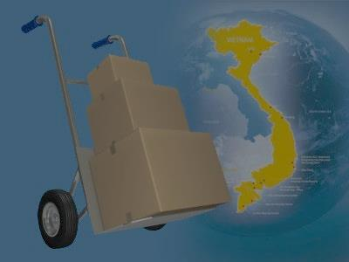
A web-based application that manages the activities of delivery service system by coach
i-DELIVER
SPRING 2014 - Group 18
1

Slide 2
Team members
Supervisor: Nguyễn Trọng Tài
Nguyễn Thanh Tùng
Lê Phúc Lữ
Nguyễn Tấn Đức
Team leader: Đào Bảo Long
2

Slide 3
Outline
Scenario problems
Propose solution
Feature and constraint of new system
Demonstration
Future plan
Technology & development environment
Algorithm description
3

Slide 4
Scenario problems
Paper documents
Ineffective manual work
Lack of statistics report
Unable to tracking, manage packages
4

Slide 5




Actors of system
Customer: person requests for package delivery from their location to another location.
Guest: same as customer but don’t log in
to system so be restricted in some function.
Staff: persons in charge of manage delivery request and manage journey.
System admin: person take
responsibilities of manage staff
and fee.
5

Slide 6


Propose scenario
[Optional] Payment online
Post request
Notify payment
information
Provide delivery
service, tracking request
Manage services,
users
Manage journey
information, request
Provide mechanism to manage
Provide mechanism to manage
6

Slide 7







Technology & development environment
15

Slide 8



Problem description
1
Cà Mau – Cần Thơ, V=100dm³
Đã xếp lịch
2
Cà Mau – Đà Lạt, V=200dm³
Đã xếp lịch
3
Cần Thơ – Sài Gòn, V=300dm³
4
Cần Thơ – Đà Lạt, V=300dm³
4h
3h
8h
Đà Lạt
Cần Thơ
Cà Mau
Sài Gòn
3
1
7:00 AM 3/6,
V = 4700 dm³
4
2
7:00 AM 3/6,
V = 4800 dm³
Cần Thơ – Đà Lạt,
V = 3000 dm³
Cà Mau – SG,
V = 5000 dm³
7

Slide 9
Problems
Trip | Cà Mau | Cần Thơ | Sài Gòn | Đà Lạt | Đà Nẵng | Volume
1 |  |  |  |  |  | 300
2 |  |  |  |  |  | 350
3 |  |  |  |  |  | 400
4 |  |  |  |  |  | 240
Requests (from A to B)
Cà Mau – Cần Thơ: 30 dm³.
Cần Thơ – Đà Lạt: 40 dm³.
Đà Lạt – Đà Nẵng: 50 dm³.
Assign these requests that satisfying constraints about: volume, time,… to get maximum revenue.
8

Slide 10

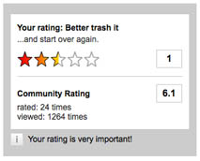

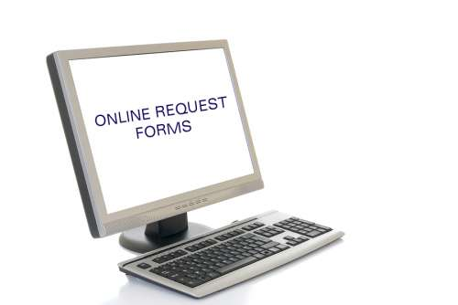
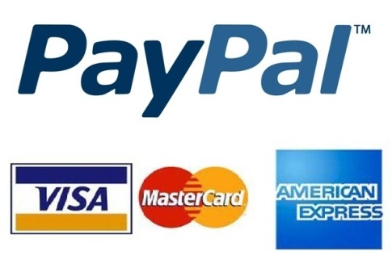
Feature of new system
Request for packages delivery easily
Simple way to tracking packages
Online payment
Easy to manage packages
Rating and comment
Statistics on revenue
16

Slide 11


Constraints of new system
Each station must have staff with basic computer skills to mange request & journey
Each station must have computer connects to Internet
17

Slide 12
DEMONSTRATION
18

Slide 13



Future plan
Develop mobile applications for manage packages pick-up/delivery process at customer’s house
Develop and optimize algorithms for coach scheduling and reduce cost of delivery process
19

Slide 14
Thanks for your listening! Q&A
20

